Slide 1
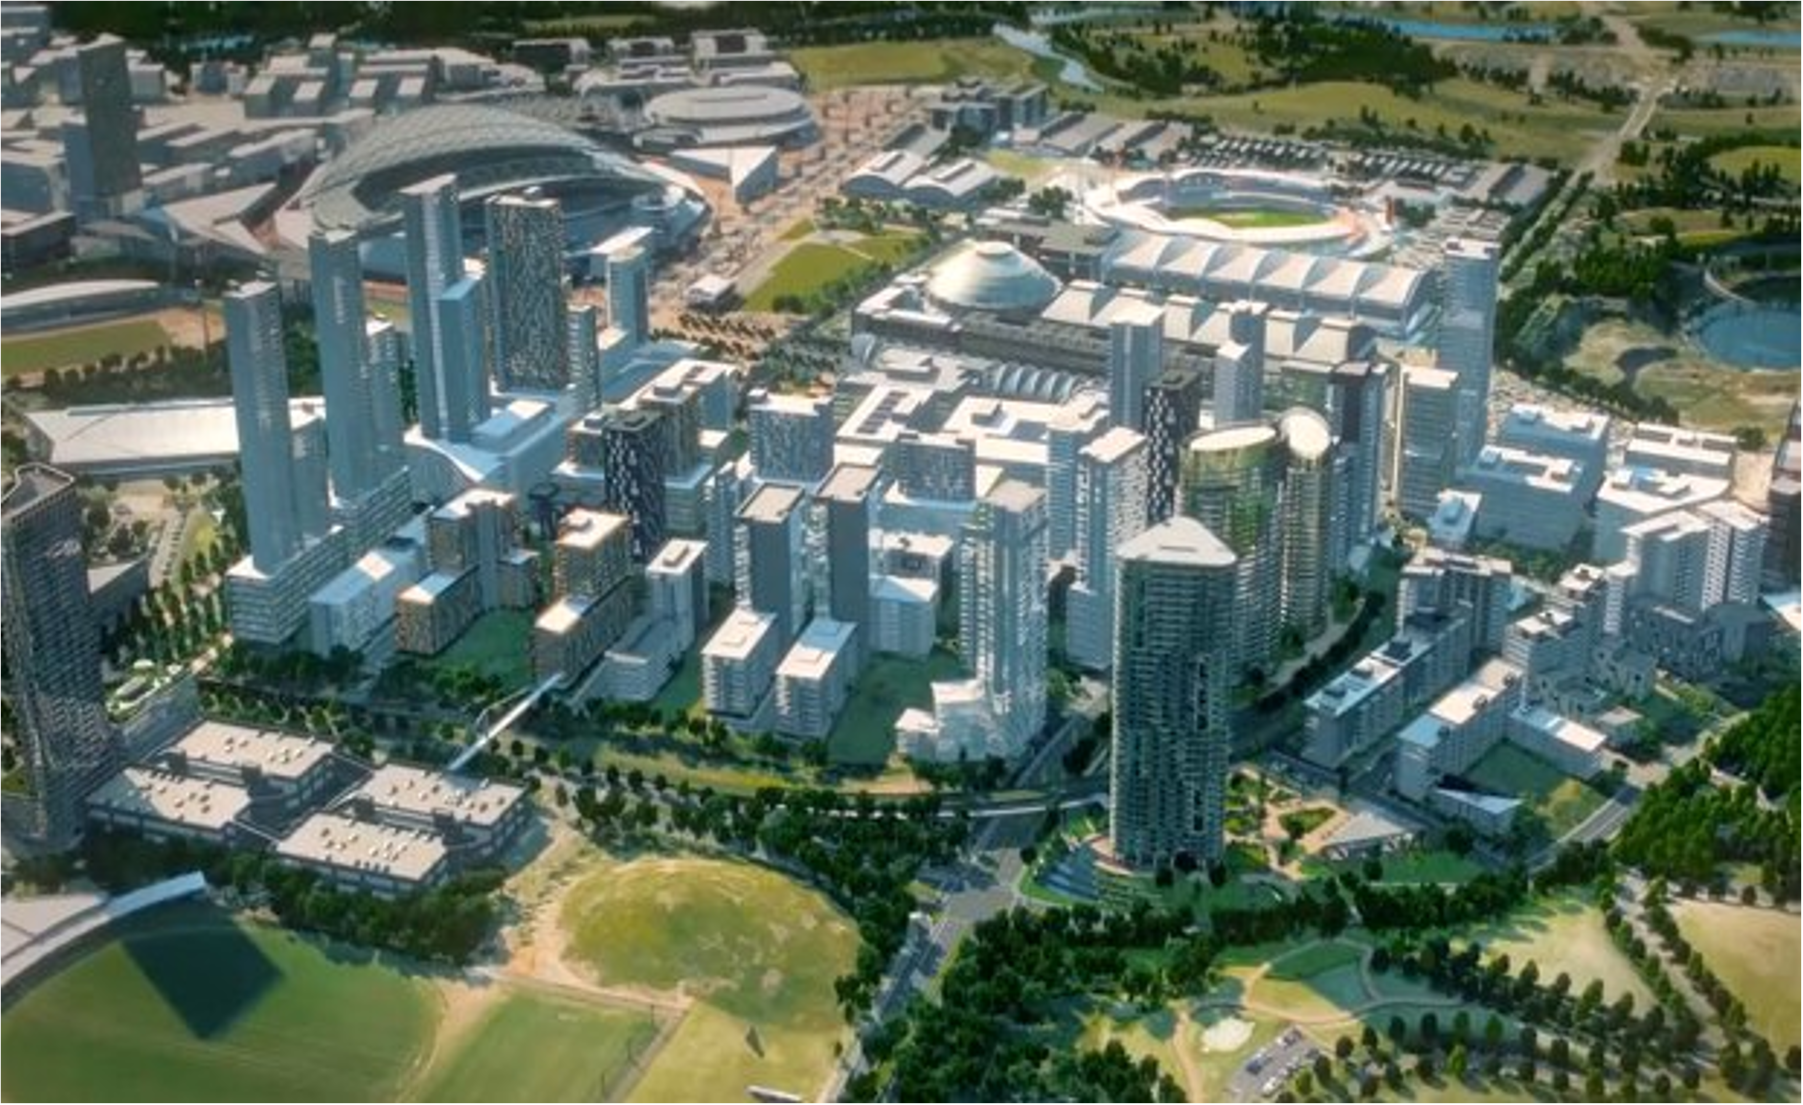
Sydney Olympic Park Smart City Development
MGMT8040 Business Project Management
Group 7
Aryaman Manhas | 48022179
Mohd Amaan | 47943734
Manoj Kumar Munikrishnappa | 48040029
Hassan Mohammad | 47892714
Muntasir Md Nafis | 48312932

Slide 2


Project Introduction and Background
Scope: Sydney Olympic Park Smart City Development integrates technology and sustainability.
Urban Transformation: Established on the 2000 Olympic site, it aims to create a future-focused urban center.
Sustainability Goals: Designed to meet both immediate and long-term ecological needs, targeting a 6-Star Green Star rating.
Smart City Vision: Focused on efficient infrastructure, public spaces, and good connectivity for residents and visitors.
Aryaman

Slide 3
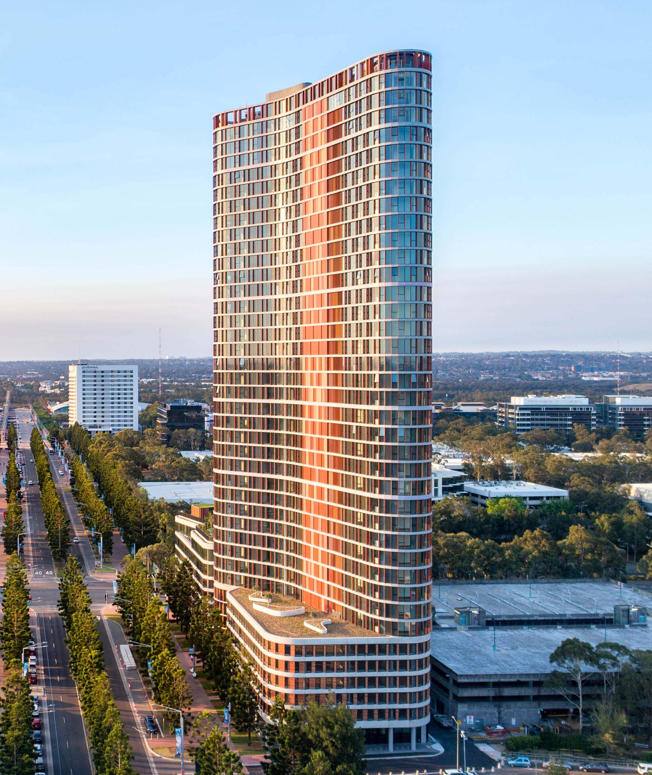
Parties Involved and Collaboration
Lead Agency: Sydney Olympic Park Authority (SOPA) manages the project and overall governance.
Collaboration: Involvement of local/state governments, private-sector contractors, and tech companies (e.g., Microsoft).
Community Engagement: Residents participate as part of the "Smart City Advisory Panel," ensuring a community-responsive project.
Aryaman

Slide 4
Project Planning and Scope Definition
Key Phase: Planning laid the groundwork for smart infrastructure and sustainability.
Focus on Innovation: Transforming Sydney Olympic Park into a smart city using advanced technology.
Scope: Addressing public spaces, transit systems, and residential development.
Amaan

Slide 5
Project’s Purpose and Planning Tools
Sustainable Systems: Integrated smart lighting, water, and transport solutions.
Balancing Innovation and Environment: Ensuring technology does not harm the environment.
Tools: Work Breakdown Structure (WBS) to organize tasks and set deadlines.
Amaan

Slide 6
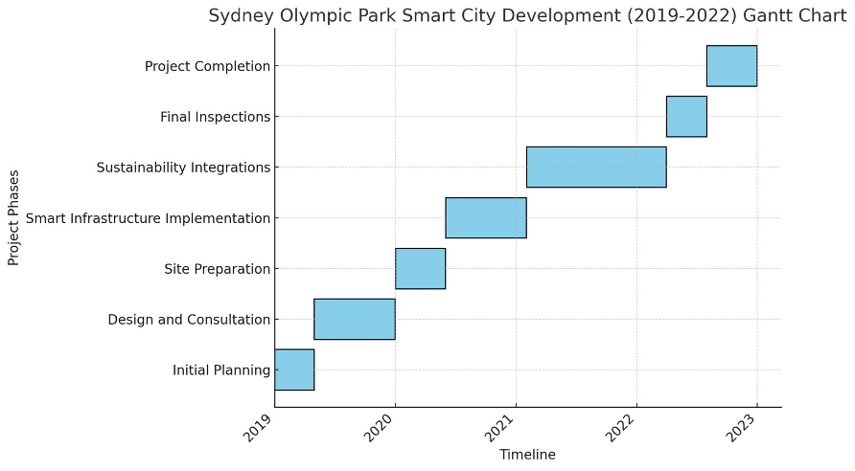
Gantt Chart and Managing Delays
Gantt Chart: Used to manage project timelines and milestones efficiently.
Overlapping Tasks: Some phases, like infrastructure and sustainability, were completed concurrently.
Challenges: Delays due to tech procurement and legal adjustments.
Amaan

Slide 7
Key Risks and Challenges
Major Challenges: Environmental hazards, community opposition, budget limitations.
Environmental Risks: Addressed through Ecologically Sustainable Development (ESD) principles.
Financial Risks: Managed using Public-Private Partnerships (PPP) for secure funding.
Manoj

Slide 8
Risk Mitigation Strategies
ESD Principles: Balanced environmental conservation with urban development.
Community Pushback: Public consultations and workshops addressed traffic, land use, and disruption concerns.
Financial Strategy: Long-term success of venues like Telstra Stadium due to effective PPP.
Manoj

Slide 9
Stakeholder Engagement
Governance: Collaboration among corporations, government, and communities.
Community Involvement: Residents engaged via the "Smart City Advisory Panel" and public consultations.
Outcome: Stakeholder input shaped decisions on sustainability and infrastructure.
Manoj

Slide 10
Project Implementation Overview
Key Focus: Deploying cutting-edge smart technologies for sustainability and innovation.
Smart Infrastructure: Installed intelligent lighting, advanced water management, and smart waste systems.
Goal: Reduce environmental impact while enhancing urban livability.
Hassan

Slide 11
Smart Technology and Monitoring
Smart Lighting: Adaptive brightness based on pedestrian activity.
Water Management: Sensor-based systems for optimized water usage.
Waste Management: Smart bins with sensors to streamline waste collection.
Monitoring: Performance metrics and regular progress reports on energy savings, water usage, and waste management.
Hassan

Slide 12
Challenges and Management Strategies
Challenges: Delays in technology delivery due to supply chain disruptions.
Solutions: Agile management techniques used to adjust timelines and resources.
Time, Scope, and Budget Management: Gantt charts used to track progress and adjust scope; budget tracking to prevent cost overruns.
Hassan

Slide 13
Project Outcome
Urban Renewal: Balanced historical preservation with smart city innovations.
Sustainable Environment: Integrated smart lighting, water conservation, and waste management technologies.
Community Hub: Revitalized the area, turning Sydney Olympic Park into a cultural and economic center.
Nafis

Slide 14
Success Metrics
6-Star Green Star Rating: Excellence in sustainable building design (Johnson & Kent, 2021).
Improved Public Transport: New bus and train routes enhanced accessibility and boosted daily commuting.
Economic Growth: Increased tourism, major events, and new businesses attracted to the area (Smith, 2022).
Nafis

Slide 15
Critical Analysis
Challenges: Scope changes due to evolving technologies and sustainability requirements.
Conflicts: Government, corporations, and local communities clashed over balancing development and conservation.
Solutions: Agile project management, risk management, and effective change strategies minimized delays and ensured project success.
Nafis

Slide 16
Lessons Learned
Stakeholder Engagement: Regular consultations with residents, local government, and private partners ensured community support and diverse input.
Flexibility: Agile management allowed the team to adapt to challenges and scope changes.
Integration of New Technologies: Project adapted to include cutting-edge smart city technologies.
Aryaman

Slide 17
Recommendations
Sustainability from the Start: Sustainability must be embedded in project planning, but not necessarily through strict ecological models.
Technological Innovation: New approaches like nanotechnology should be explored to improve efficiency.
Lifecycle Sustainability Assessments: Impact assessments should be integrated throughout the project lifecycle for long-term ecological performance.
Aryaman

Slide 18

Project Management Approach and Task Organization
Structured Task Allocation: Tasks were assigned based on individual strengths using a Work Breakdown Structure (WBS).
Project Planning Tools: Gantt Chart used to visualize task durations, deadlines, and dependencies.
Collaboration: Regular team meetings ensured that all members stayed aligned with project goals and progress.
Hassan

Slide 19
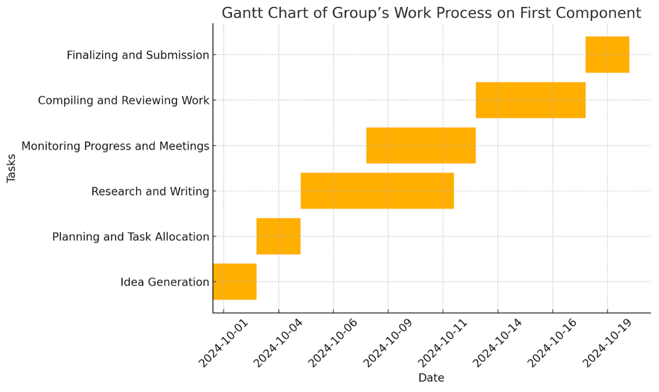
Progress Tracking and Challenges
Tracking Progress: Used Gantt Chart to monitor task progress and overlaps.
Challenges Faced: Schedule conflicts and member availability issues.
Risk Management: Frequent check-ins, reallocation of tasks, and adjustments to timelines to stay on schedule.
Amaan

Slide 20
Project Outcomes and Team Performance
Successful Completion: Project stayed on track and met deadlines due to flexible planning.
Team Dynamics: Strong communication and collaboration were key to resolving issues and maintaining momentum.
Lessons Learned: Emphasis on flexibility, better scheduling, and improved communication for future group work.
Nafis

Slide 21
Any Questions ?

Slide 22
Thank You

